Slide 1
Banking System
Chaitanya Garg – 2210990233

Slide 2
Index
Objective
Introduction
Methodology, Approach & Techniques
Algorithm
Flow Chart
Result
Source Code (screenshots)
Conclusion
Reference

Slide 3
Objective
Design and implement a user-friendly interface for account creation, deposit, withdrawal, and balance inquiry functionalities.
Incorporate robust authentication mechanisms to ensure secure access to accounts and transactions.
Develop comprehensive error handling and logging systems to maintain data integrity and provide clear feedback to users in case of any issues.
Utilize encryption algorithms and best practices to safeguard sensitive customer data, ensuring compliance with regulatory standards and enhancing overall system security.

Slide 4
Introduction
In the modern digital landscape, the banking sector is undergoing a significant transformation, relying heavily on technology to deliver seamless financial services.
This project endeavors to develop a robust banking system using Python, prioritizing both efficiency and security.
The system aims to streamline essential banking operations such as account management, transactions, and data security.
By combining user-friendly interfaces with stringent security measures, the project seeks to redefine the banking experience, ensuring reliability and peace of mind for both customers and administrators.

Slide 5
Problem statement
How can we develop a Python-based banking system that combines efficiency, security, and scalability to provide customers and banking administrators with a seamless and reliable platform for managing financial transactions while ensuring compliance with regulatory standards?

Slide 6
Methodology , Approach & Techniques
Methodology:
The development of the banking system will follow an iterative and incremental approach, allowing for continuous feedback and refinement throughout the development process.
Agile methodologies, such as Scrum or Kanban, will be adopted to facilitate collaboration among team members and ensure timely delivery of features.
Approach:
Requirement Analysis: Conduct thorough analysis to understand the functional and non-functional requirements .
Design: Utilize object-oriented design principles to architect the system, focusing on maintainability.
Implementation: Develop the system iteratively, starting with core functionalities such as account management and gradually adding features like transaction handling and authentication.
.

Slide 7
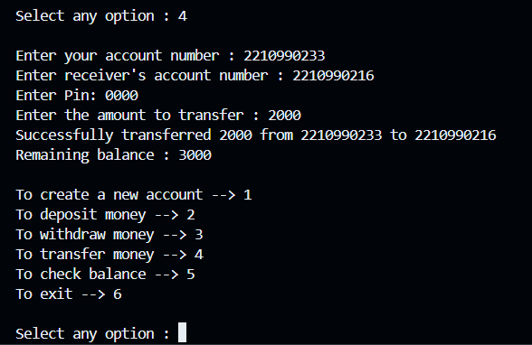
Result

Slide 8
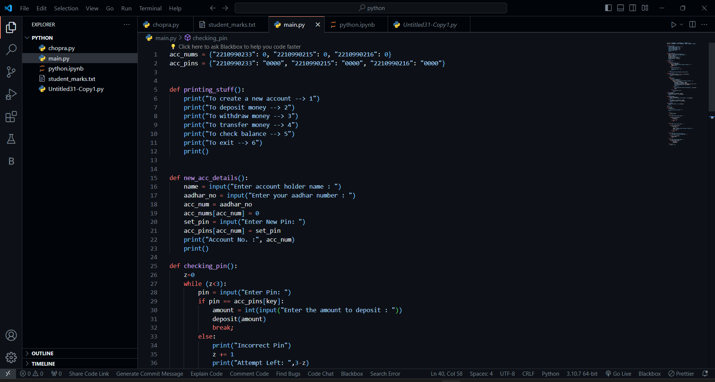
Source Code(screenshots)

Slide 9
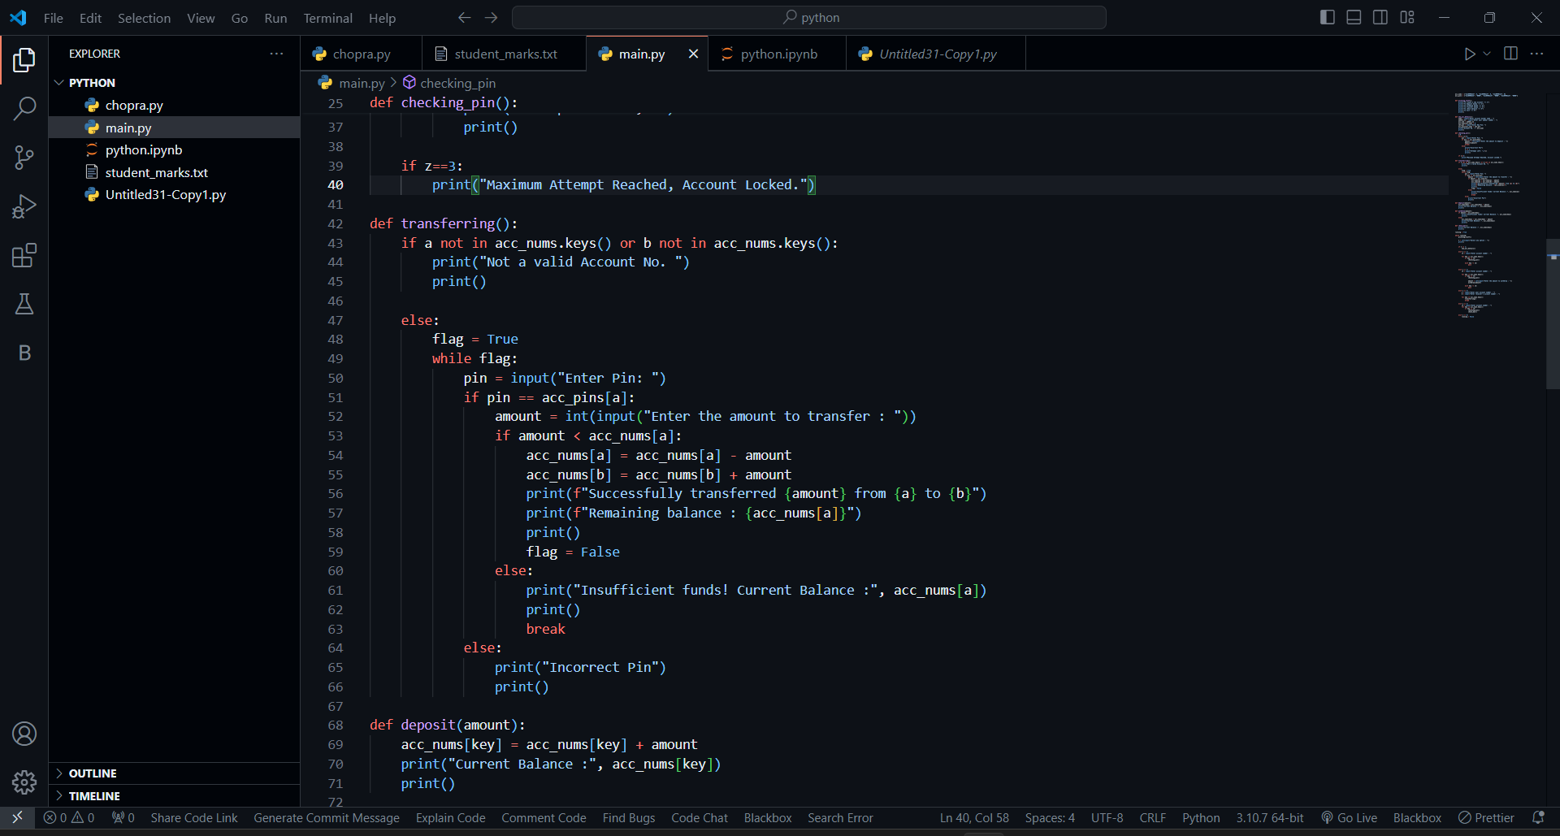
Source Code(screenshots)

Slide 10
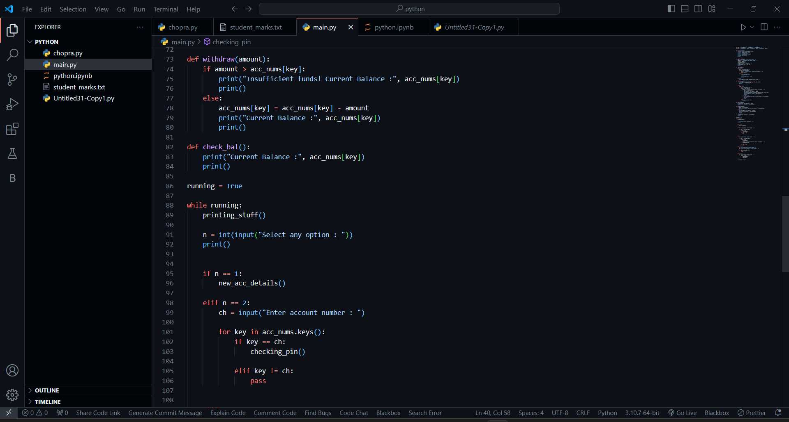
Source Code(screenshots)

Slide 11
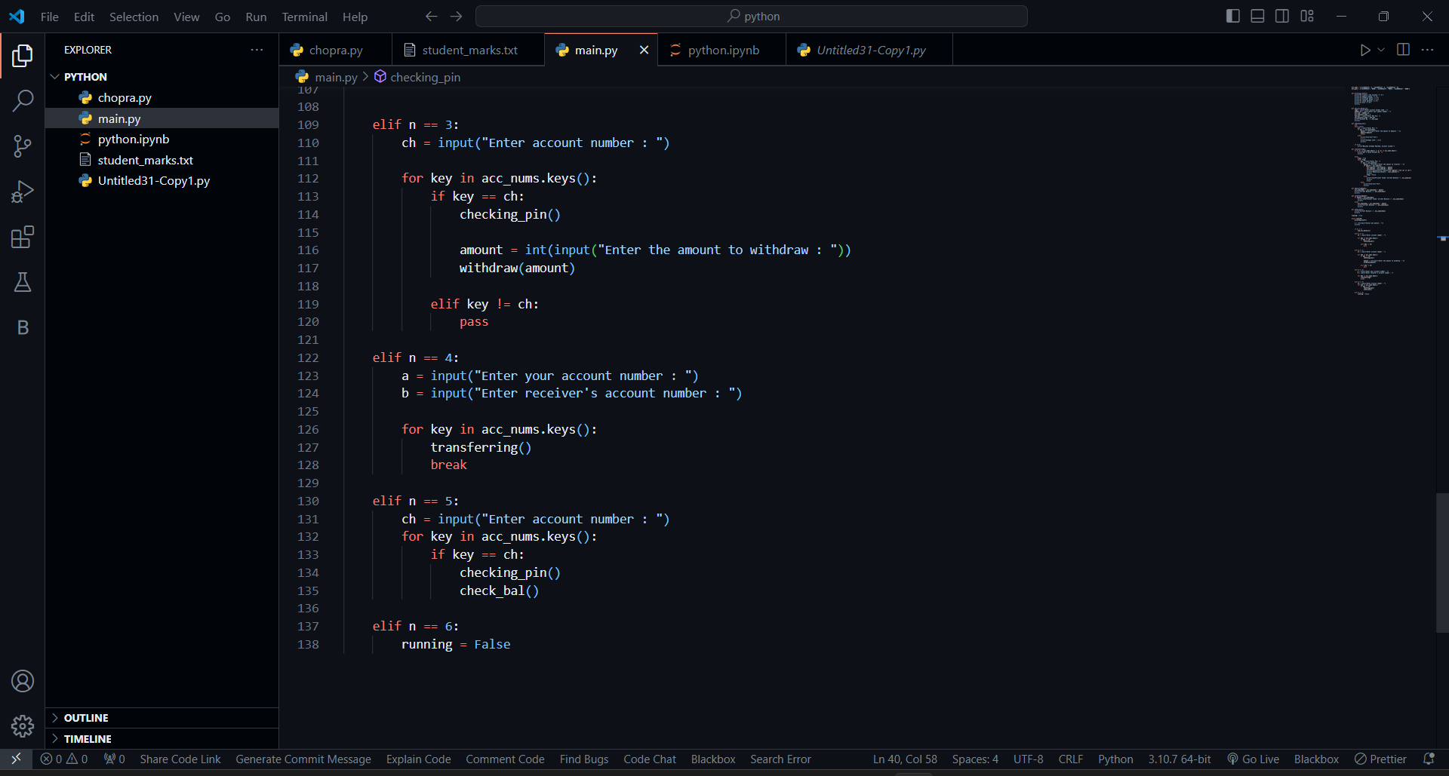
Source Code(screenshots)

Slide 12
Conclusion
In conclusion, the development of a Python-based banking system has demonstrated its potential to deliver a seamless and secure platform for managing financial transactions. By prioritizing efficiency, security, and scalability, the system addresses the diverse needs of both customers and banking institutions.
With user-friendly interfaces and robust security measures, the banking system ensures a trustworthy and convenient experience for users. Moreover, its reliability and scalability guarantee uninterrupted service and accommodate future growth.
Looking ahead, ongoing refinement and adaptation will be crucial to keep pace with evolving technologies and customer expectations. By remaining proactive, the Python-based banking system will continue to be a cornerstone of financial stability and convenience in the digital era.

Slide 13
Reference
[1] Stack Overflow, https://stackoverflow.com/, Accessed on March 4, 2024.
[2] Canva. (n.d.). Create Beautiful Designs with Canva. Retrieved from https://www.canva.com
[3] geek for geek :www.geekforgeek.com
[4] youtube

Slide 14
The End

